Slide 1
Oracle Data Integrator (ODI)

Slide 2
Introduction to ODI
Is a comprehensive data integration platform that covers all data integration requirements: from high-volume, high-performance batch loads, to event-driven, trickle-feed integration processes, to SOA-enabled data services;
ODI12c further builds on its flexible and high-performance architecture with comprehensive big data support;
And Parallelism when executing data integration processes.

Slide 3
Overview ETL

Slide 4
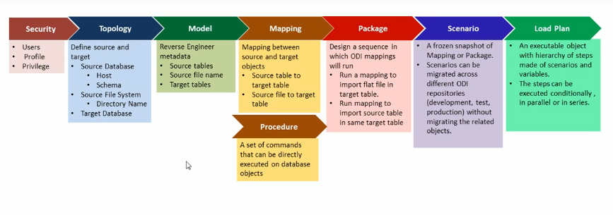
Architecture ODI
Operator
Designer
Profile
Users
Objects
Architecture:
Physical
Logical
Contexts
Languages
Repositories
Generic Action
Session List
Hierarchical Sessions
Load Plan Executions
Scheduling
Load Plan and Scenarios
Labels
Projects
Models
Dimensions and Cubes
Load Plans and Scenarios
Global Objects
Labels

Slide 5
Security
Users;
Profile;
Privilege.

Slide 6
Topology
Define Source e Target

Slide 7
Model

Slide 8
Mapping

Slide 9
Procedure

Slide 10
Package

Slide 11
Scenario

Slide 12
Load Plan

